Slide 1
Deep Learning_2주차
Department of Data Science
Hyun seok Lee

Slide 2
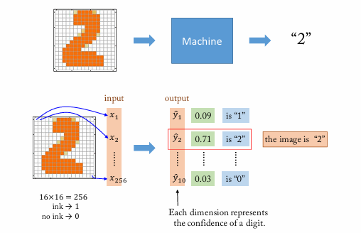
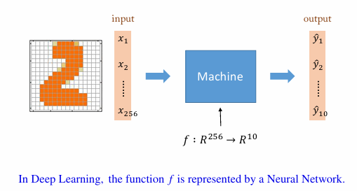
1. Deep Learning Motivation

Slide 3
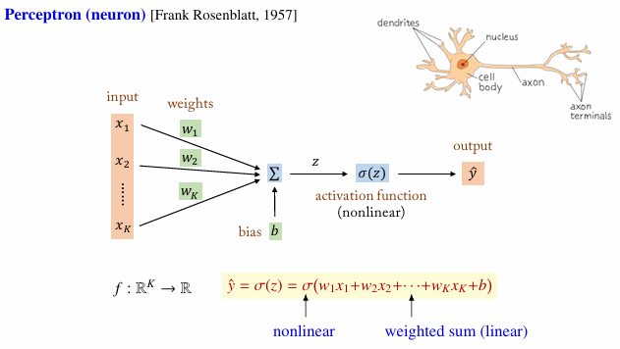
2. Perceptron

Slide 4
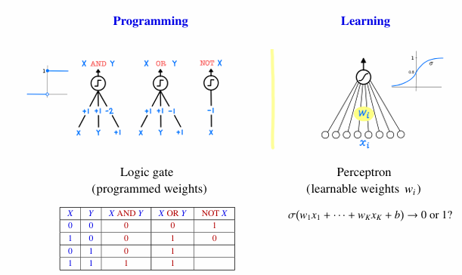
2. Perceptron

Slide 5
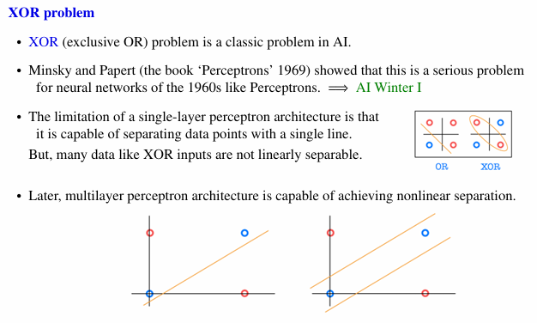
3. XOR Problem

Slide 6
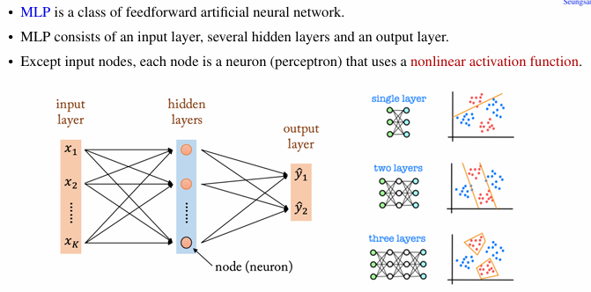
4. Multilayer Perceptron (MLP)

Slide 7
감사합니다
Thank you

